Slide 1
Tuesday January 28th, 2014

Slide 2
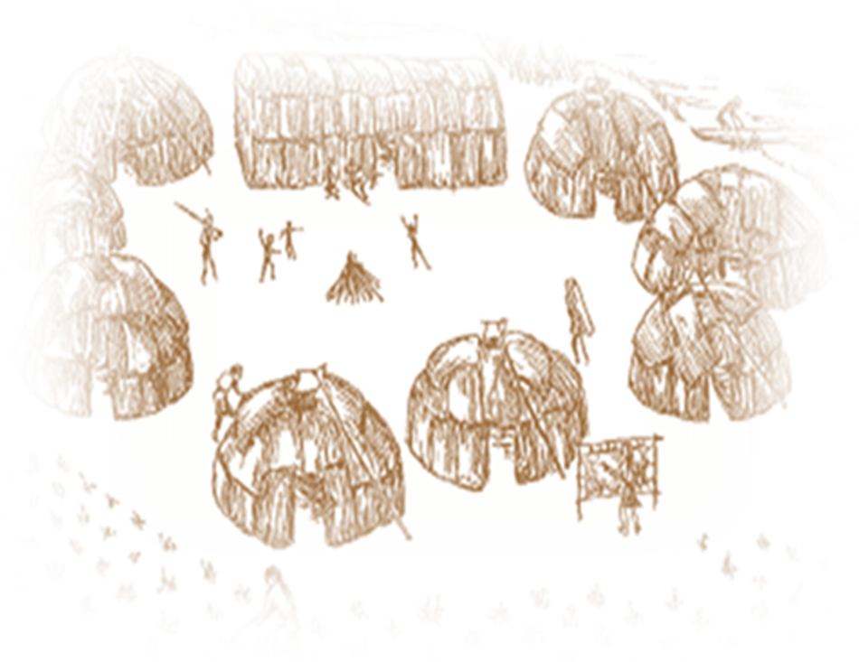
Native Americans of East Haven and the Area—Introduction to the Quinnipiacs
· What did they look like?
· What did they wear?
· What did they live in?
· Area Sites
· Momauguin, Foxon, Montowese

Slide 3
A Brief Introduction
The Quinnipiacs were the original Native Americans of the East Haven and New Haven areas.
‘Prior to the arrival of European settlers in the 1630s, East Haven was occupied by the Quinnipiac Indians. The Quinnipiacs grew crops and utilized the Farm River.’
In 1638, English settlers purchased this land from Momauguin, chief of the Quinnipiacs…Settlers ventured to the east side of the river and began to establish farms… Stands of pine trees established the town border.’
Source: East Haven Town Green Tree Preservation Project
According to DeForest In Indians of CT. They had long suffered heavy taxes and attacks from the Pequots and so welcomed the English in the hope of having some refuge in their protection and opportunity to live in peace

Slide 4
They were part of the Algonquin language group that migrated from Canada.
They spoke the Quiripi dialect (now extinct) though some words have been preserved. The word in Quiripi for East Haven was: Mioonkhtuck.
Threat from the Pequots, Mohawks and others forced them to go to English for refuge and was no doubt a factor in deeding their land to the colonists.

Slide 5
The first and most crucial treaty between the Quinnipiacs and the English was signed November 24th 1638 with the Reverend John Davenport and Theophilus Eaton.
Momauguin…accompanied by his counselors Sugcogisin, Carroughood and Wesacucke his sister Shaumpishuh…his uncle Qussuckquansh, Sachem of Totoket and 47 warriors – journeyed to town to meet Reverend John Davenport and Governor Eaton who led the English colonists. (Menta p. 85)
The Quinnipiac sachems then addressed what was for them the main issue- their desire for English military protection from their Indian enemies.

Slide 6
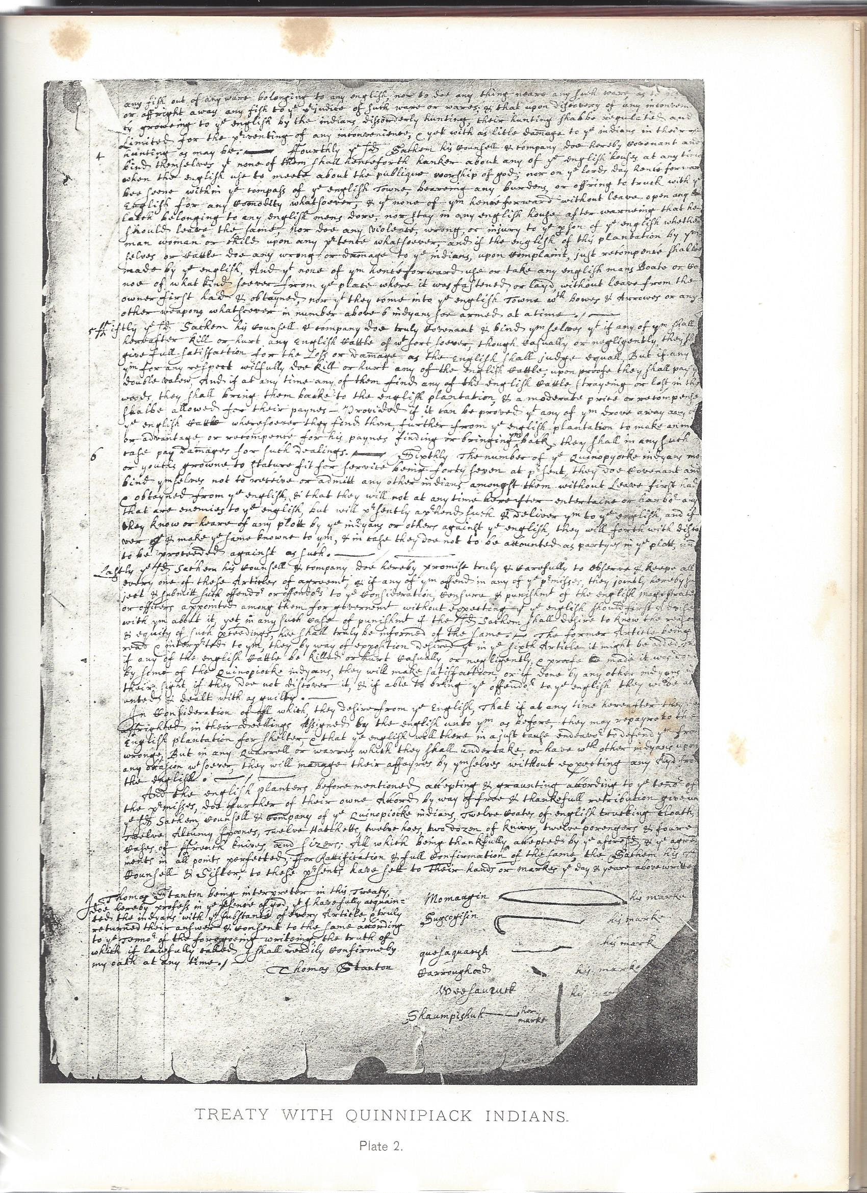
Part of the 1638 deed is seen at left with signature marks of Momauguin his sister Shaumpishuh
From The Quinnipiack Indians and Their Reservation by Charles Hervey Townshend Used with permission

Slide 7
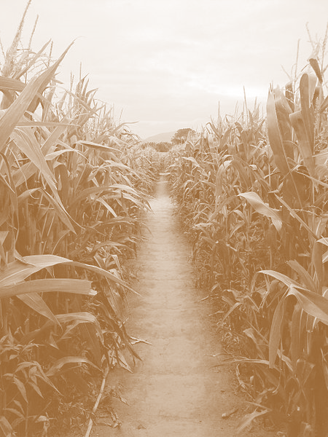
They deeded the ownership of their land to the colonists “to ye utmost of their bounds East, West, North, South...” reserving a 1,200 acre tract of land on the east side of the harbor where his band could reside and farm. (Menta p. 86)
As time went on and the Quinnipiac population increased, the tract of land set aside no longer supported the tribe. They petitioned to lease land back from the English.
Over time cultural conflict between the Quinnipiac and the English arose particularly in the areas of customs, livestock and agriculture. Notable incidents were the killing of English hogs by Quinnipiac dogs and the demand by the English that the Quinnipiacs kill all their dogs. Another was the trampling of the Quinnipiac crops by the English cows.

Slide 8
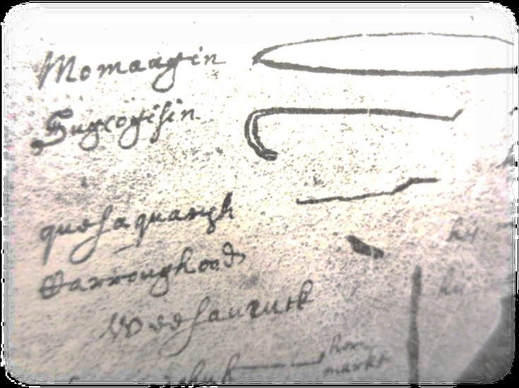
‘The Quinnipiacs had been reduced to forty-six warriors by the date of the Eaton treaty. Many braves had been murdered by the powerful Pequots. The entire tribe then numbered about one hundred fifty persons, having been scourged by a plague in 1616 that nearly drove it out of existence.’ Townshend Heritage p. 6
From The Quinnipiack Indians and Their Reservation by Charles Hervey Townshend used with permission

Slide 9
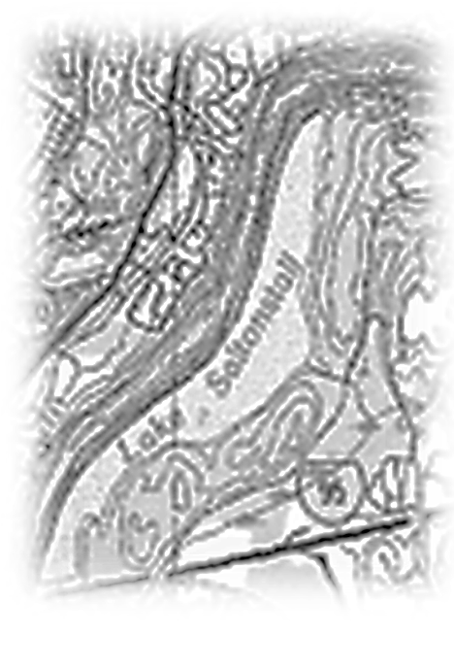
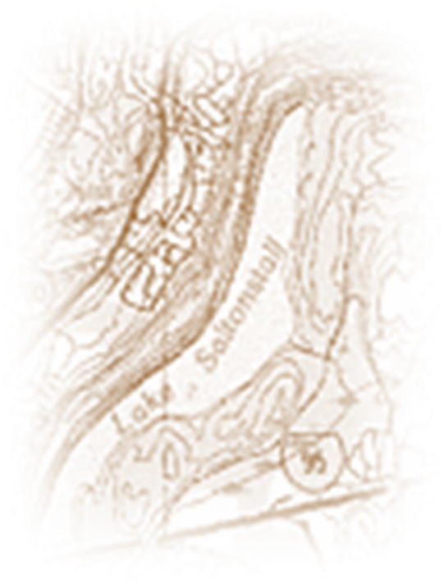
In "The Quinnipiack Indians and Their Reservation," Charles Hervey Townsend states that the name Quinni-pe-auke means ‘long-water land’ or country.
Lonotonoquet means “Tear of the Great Spirit” the name for what is now Lake Saltonstall.
USGS

Slide 11
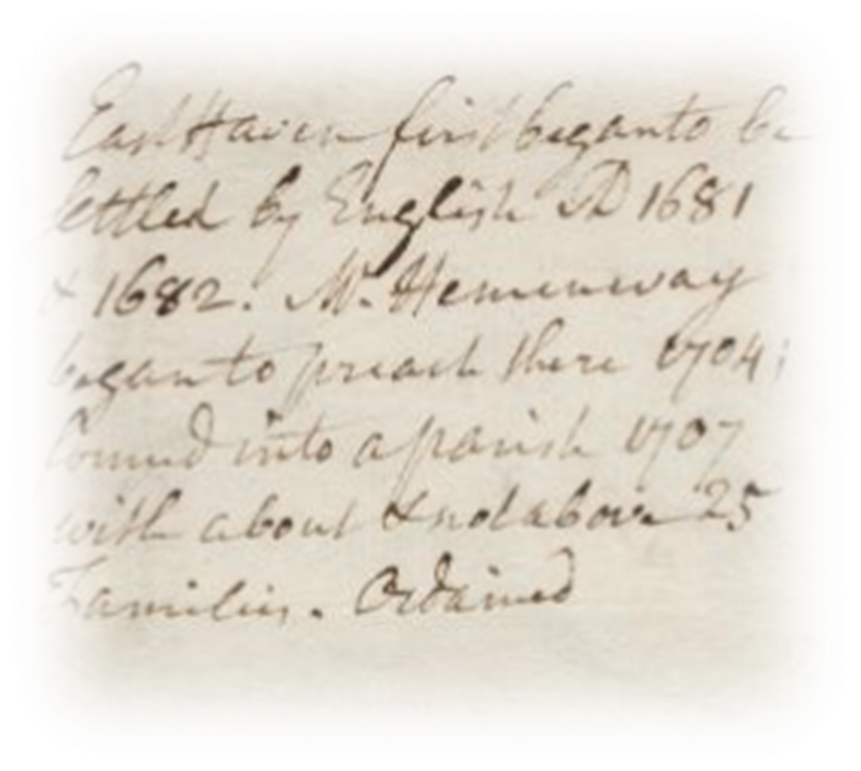
What did they look like and what did they wear?
Notes from Stile’s Itineraries

Slide 12
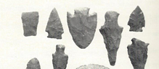
What did they look like?
John Menta in his book The Quinnipiac Cultural Conflict in Southern New England (p. 23) states that no one is certain what the Quinnipiac Indians looked like:
‘Local historian Doris Townshend has observed that no New Haven colonist ever sketched or painted one of his or her Quinnipiac neighbors.’

Slide 13
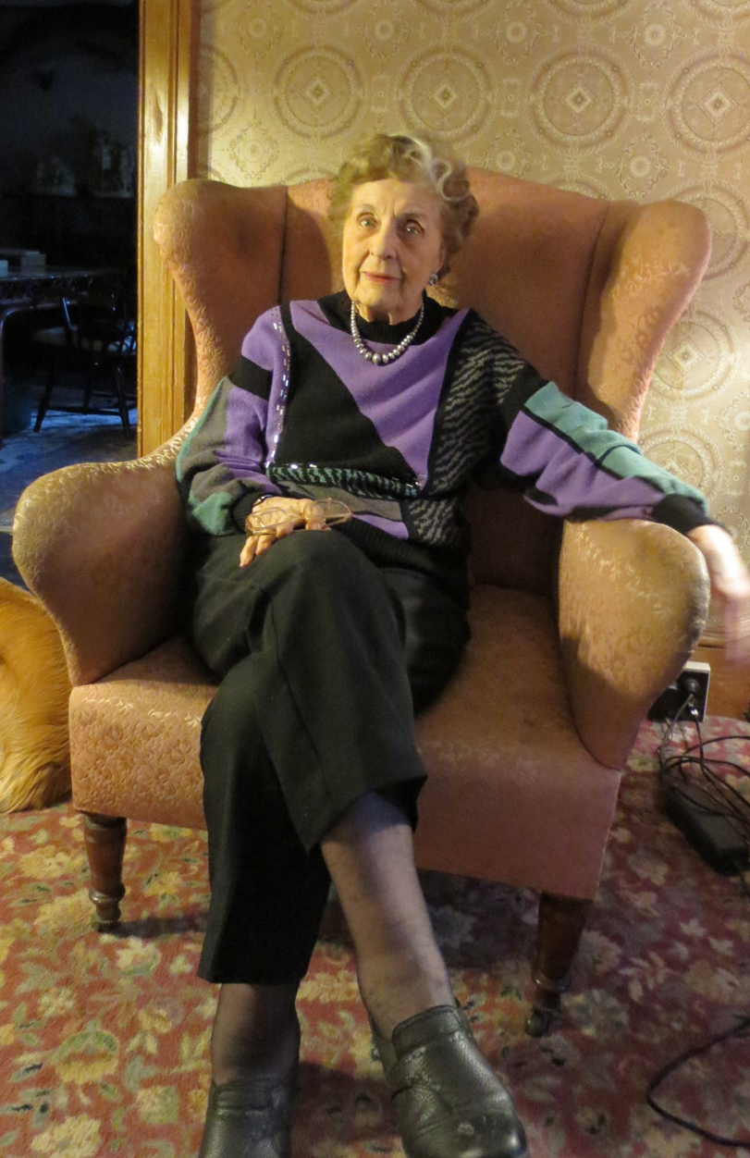
‘They deserve to be remembered for who they were- not as the name of a river or a school.’
-Doris Townshend
Mrs. Townshend has set up a monument to honor the Quinnipiacs.
New Haven Register Feb 14, 2000

Slide 14
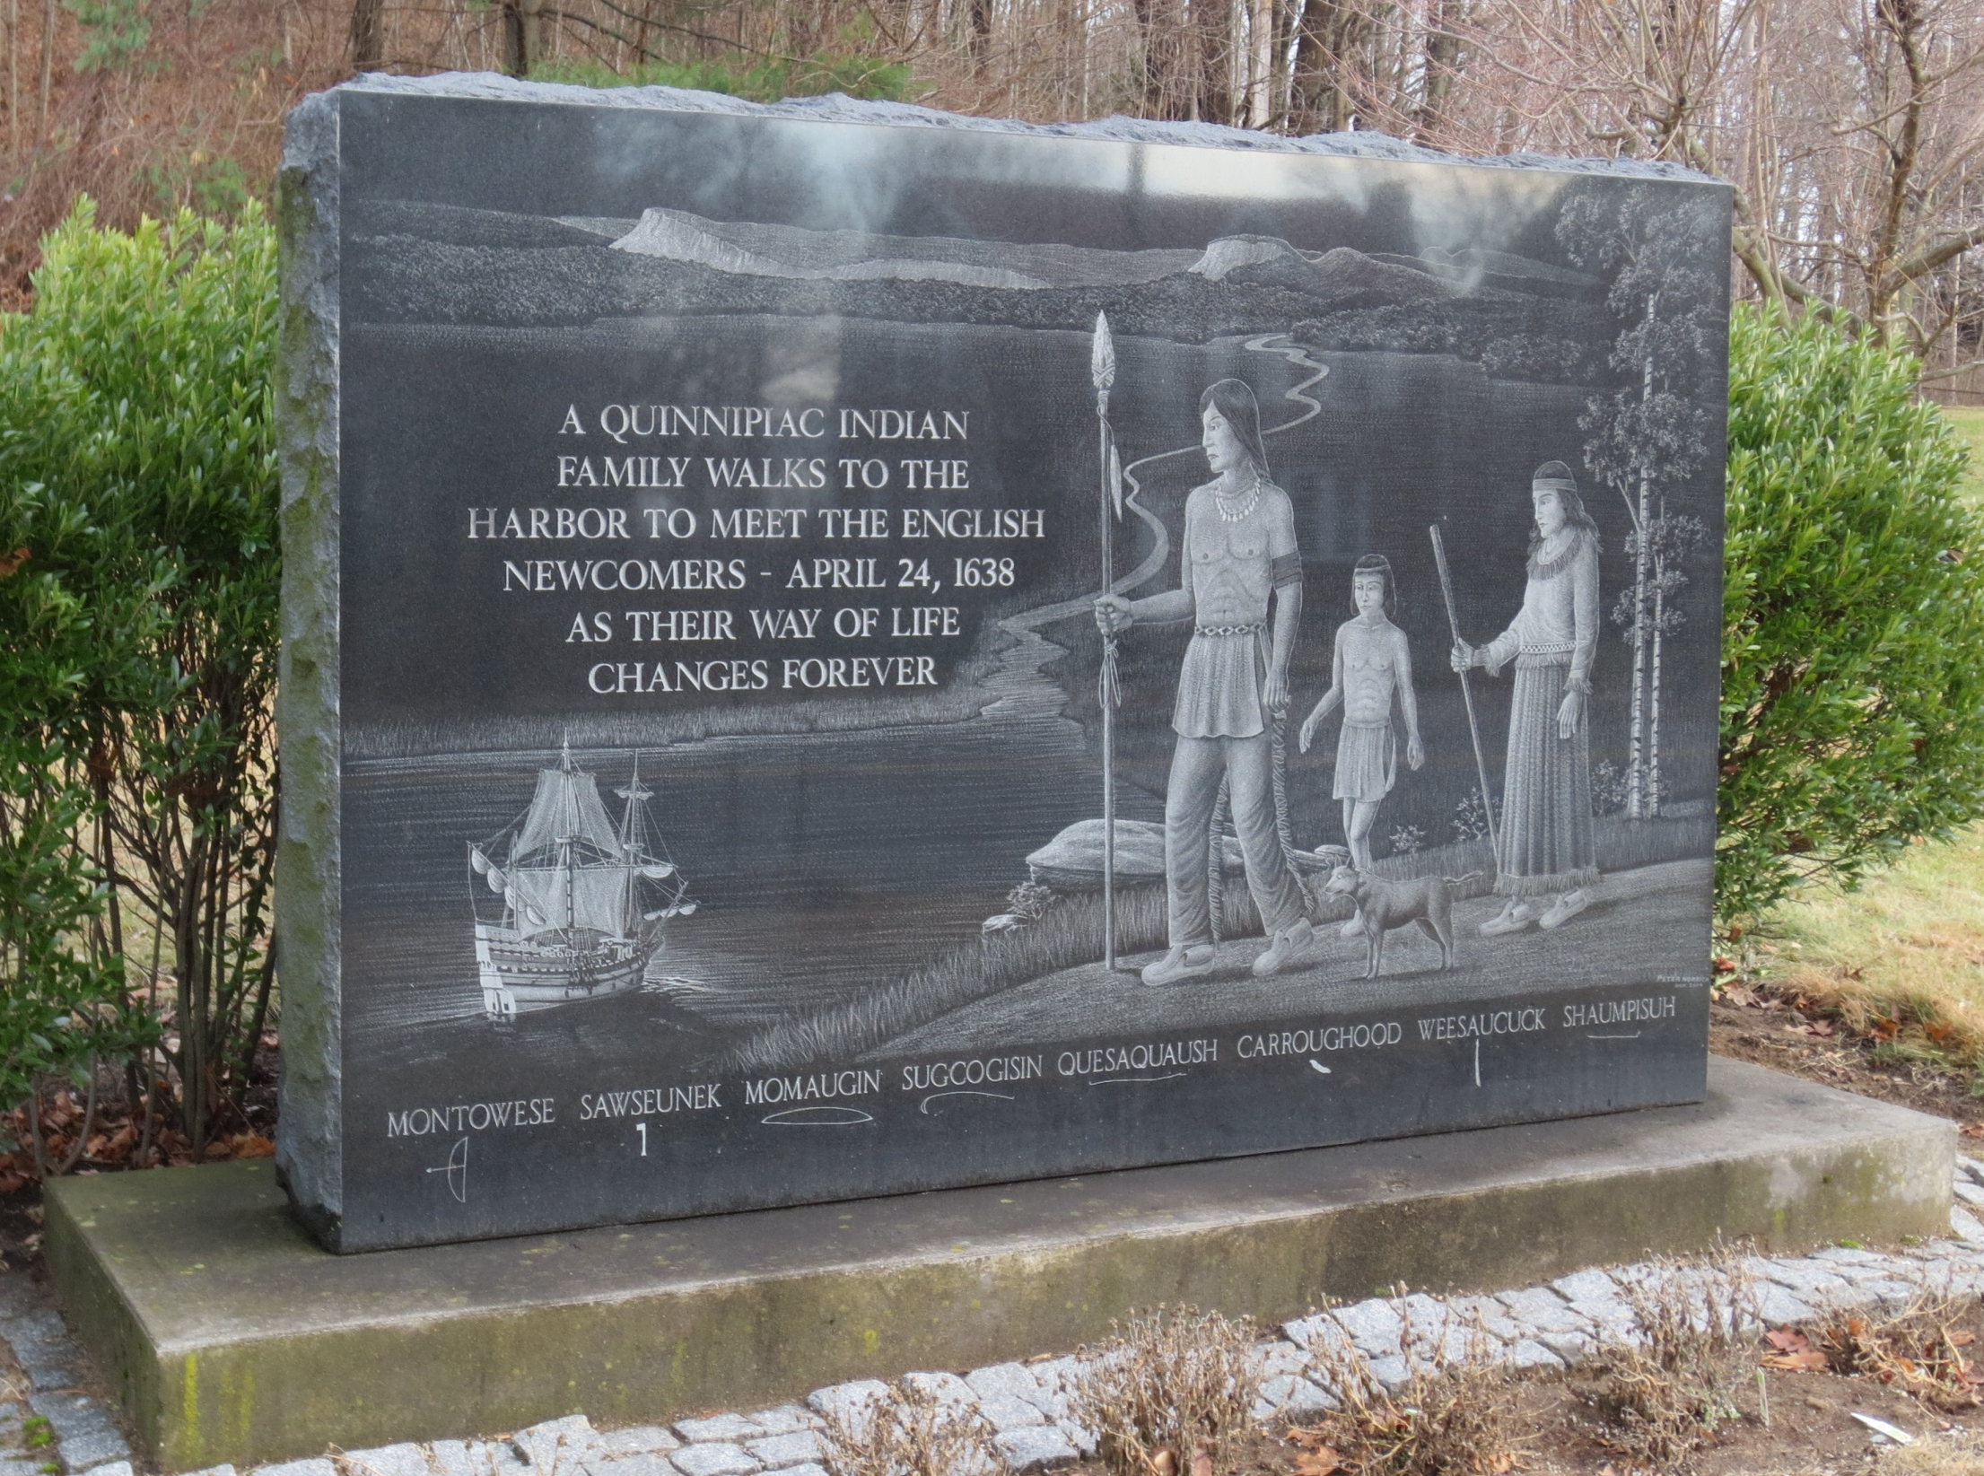

Slide 16
Other depictions: C. Keith Wilbur in his book The New England Indians presents these sketches:
C. Keith Wilbur states: That hair styles were limited only by the wearer’s imagination. From left to right: The Cockscomb- a strip of hair running down the center of the head 2. Braided trailing down the back 3. Decorated 4. top knot 5. One sided 6. Scalplock

Slide 17
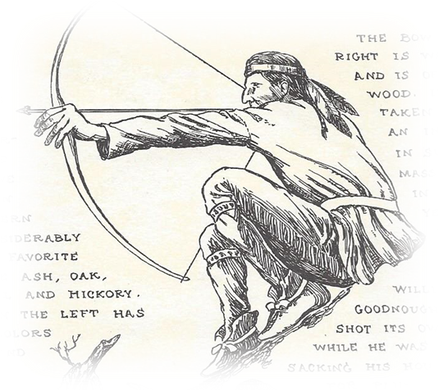
John W. Deforest in his book: History
of the Indians of Connecticut From
the Earliest Know Period to 1850
(p. 9) states:
‘ The clothing of the Indians was composed of skins, cured so as to be soft and pliable, and sometimes ornamented with paint and with beads manufactured from shells. Occasionally they decked themselves in mantles, made of feathers overlapping each other as on the back of a fowl…’
The dress of the women consisted usually of two articles: a leather skirt, or under garment, ornamented with fringe; and a skirt of the same material, fastened round the waist with a belt and nearly reaching to the feet.’

Slide 18
Another depiction by C. Keith Wilbur showing what De Forest described as “leggins of dressed deer skin.”

Slide 19
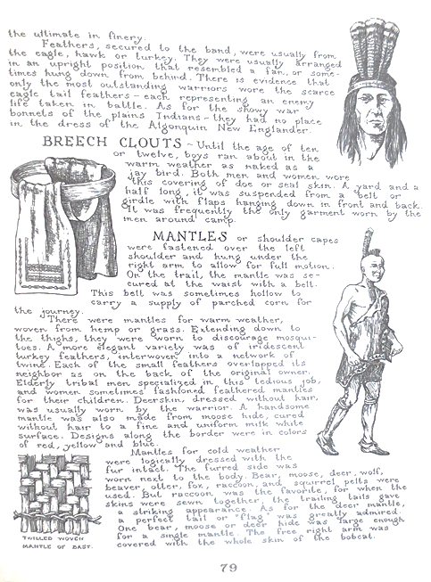
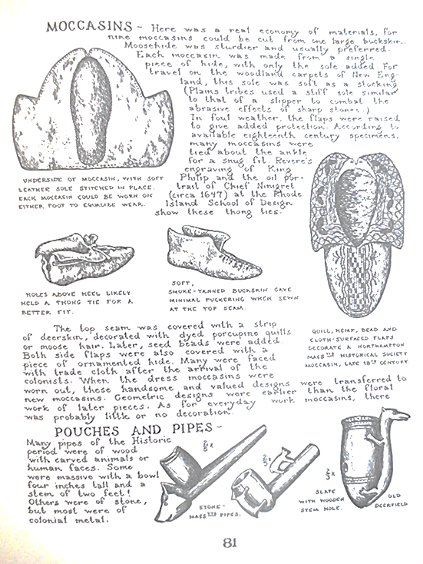
Further depictions of clothing from C. Keith Wilbur of Native Americans and clothing in his book, The New England Indians.

Slide 20
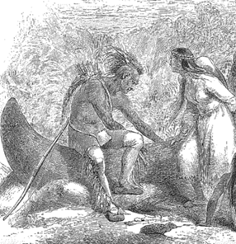
Detail from a depiction in John W. De Forest’s book Indians of Connecticut by Felix Octavius Carr Darley, an American painter and Illustrator .

Slide 21
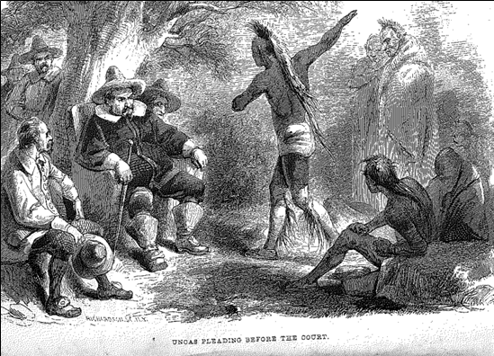

Slide 22
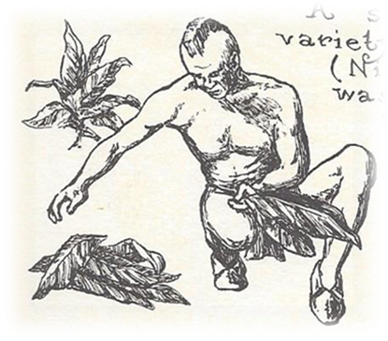
C. Keith Wilbur

Slide 23
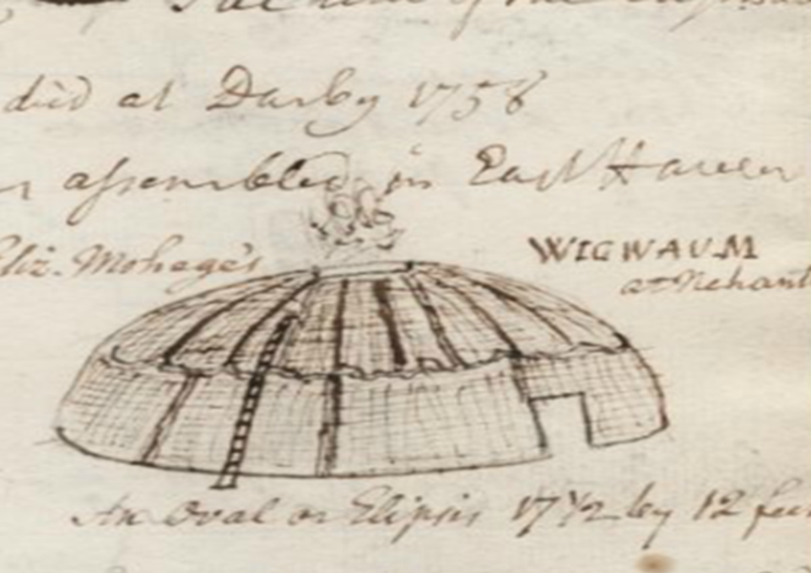
What did they live in?
Ezra Stiles, ( 1797-1795) past president of Yale, had a great interest in Connecticut’s Native American people and took notes on their way of life. Note the words “East Haven” and “Wigwaum.” This was actually drawn from a similar ‘wigwaum’ of the Nehantic tribe.
From Stile’s Itineraries number 1:497
Courtesy Yale Beinke libray

Slide 24
C. Keith Wilbur’s book The New England Indians details the construction of Native American dwellings “Wigwaum”

Slide 25
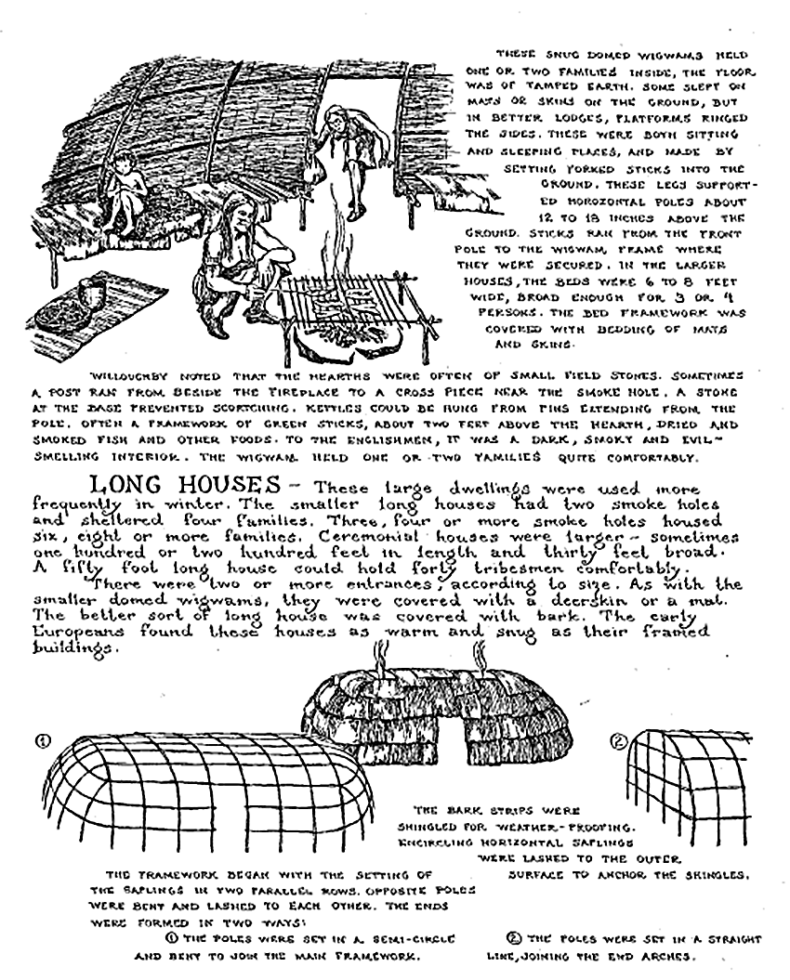

Slide 26
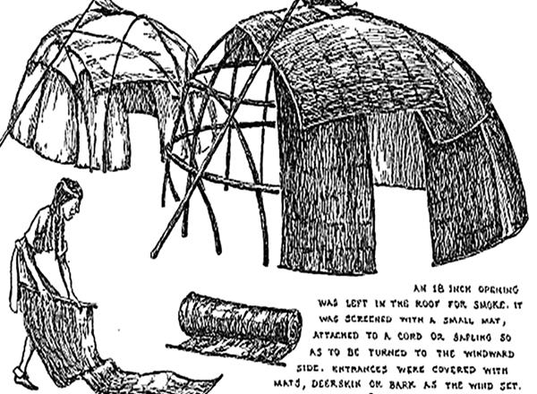
Wilbur states ‘These snug domed wigwams held one or two families inside, the floor was of tamped earth. Some slept on mats or skins on the ground, but in better lodges, platforms ringed the sides…both sitting and sleeping places.

Slide 27
The average village sheltered up to one hundred tribespeople. The wigwams were clustered about an open center space. Here the men and boys gathered for their games and ceremonies.
The palisade itself was of young trees, each about as thick as a man’s thigh or the calf of his leg. Each was ten to twelve feet above the ground and three feet below the surface. C. Keith Wilbur

Slide 28
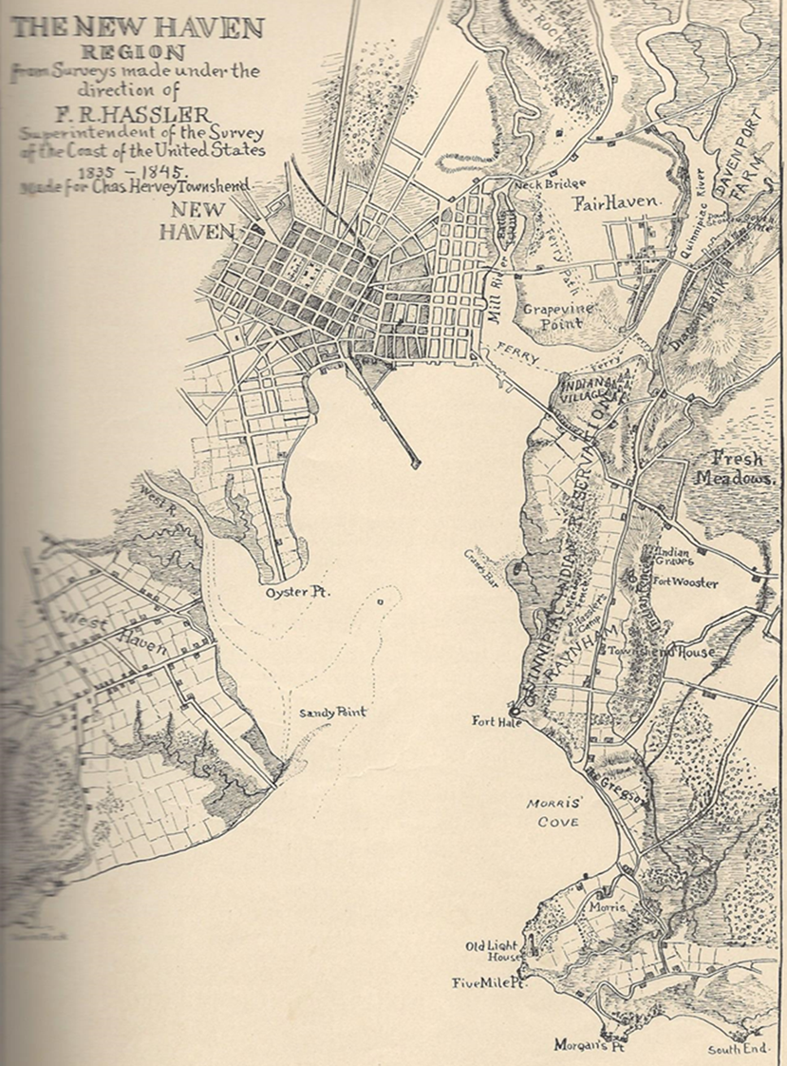
Where in the East Haven and New Haven Area were their forts and villages?
John Menta states in his book The Quinnipiac Cultural Conflict in Southern New England, p. 15, the real heart of the Quinnipiac country was situated along the east shore of New Haven Harbor.
In Charles Hervey Townshend’s The Quinnipiack Indians and Their Reservation, there is a map of the New Haven region that was based on the work of F. R. Hassler, superintendent of the survey of the coast from 1835 to 1845.

Slide 29
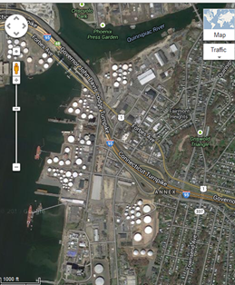
The location of Momaguin’s Indian Village- using the 1835 survey map and Google map

Slide 30
The Quinnipiacs had a fort in what is now Fort Wooster Park

Slide 31
Note the elevated area

Slide 32
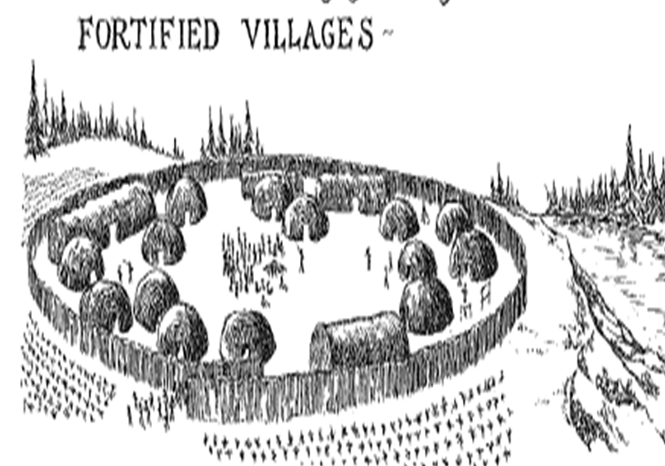
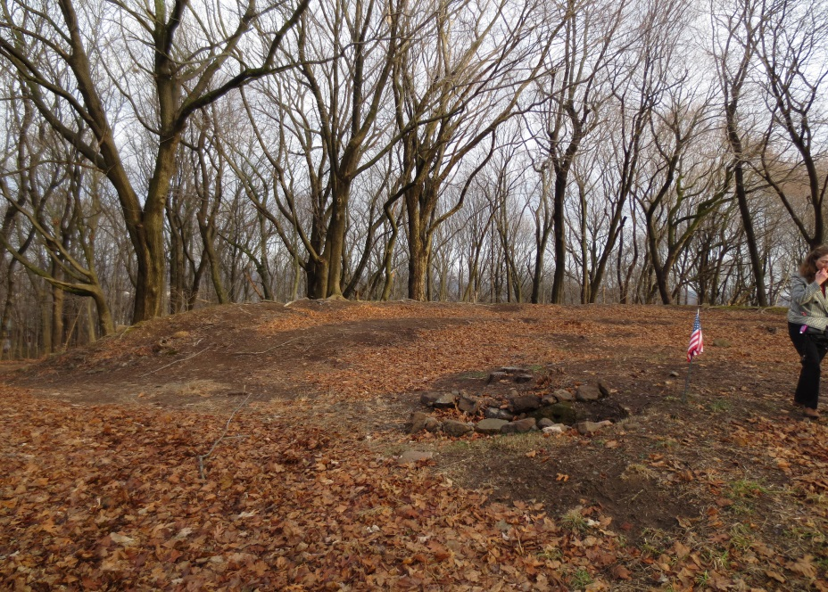
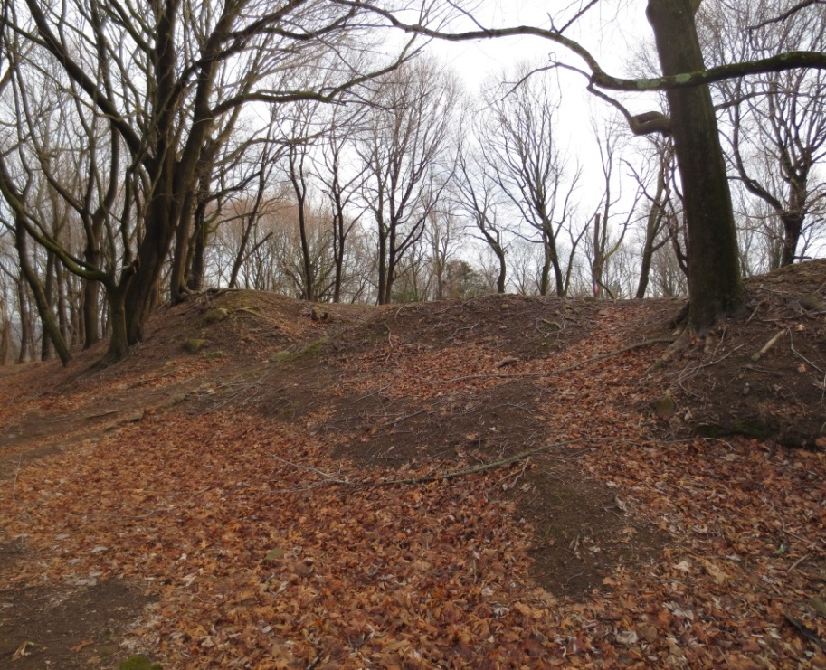
Sketch by C. Keith Wilbur
Photos we took of the former Quinnipiac Fort at Wooster Park 1/14

Slide 33
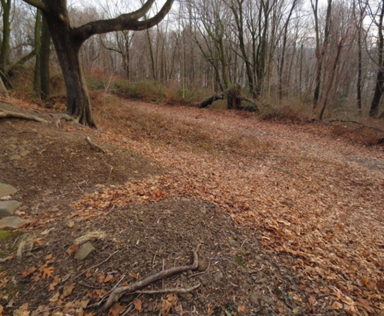
‘On the top of the hill, braves scanned Long Island Sound for vessels which might be signaled by bonfires to trade skins for blankets, knives and trinkets.’
-Townshend Heritage

Slide 34
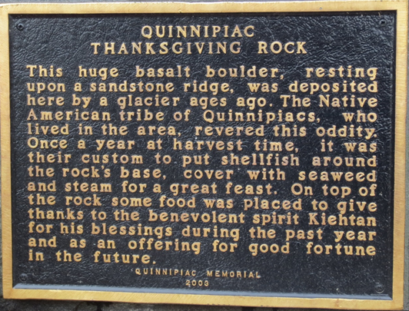
Quinnipiac Thanksgiving Rock located on Prospect Avenue.

Slide 35
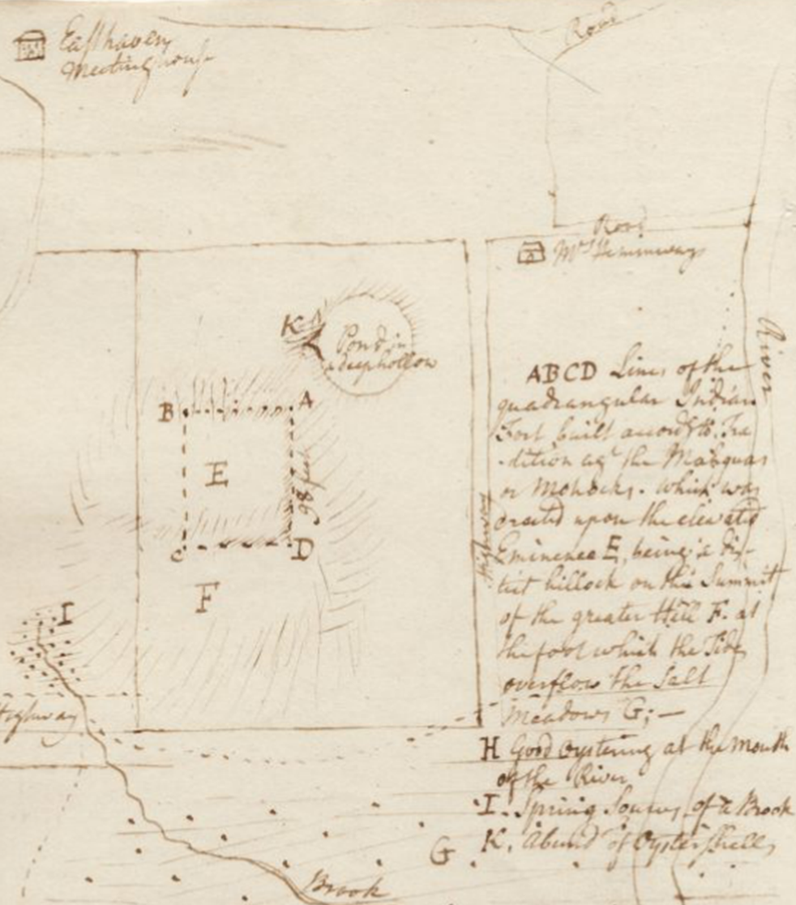
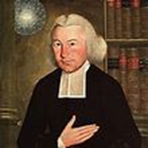
The Quinnipiac Fort in East Haven in what is now the Old Cemetery as drawn by Ezra Stiles in 1760.
East Haven Meeting House
Mr. Hemmingway
Quinnipiac Fort
Old Cemetery
Wikipedia

Slide 36
The Quinnipiac Fort in East Haven
From The Quinnipiack Indians and Their Reservation by Charles Hervey Townshend who researched the fort:
“ The East Haven Cemetery was once the site of an ancient Indian Fort and according the the records of the village, East Haven, June 13th, 1707, “It was agreed to sequester a piece of land for a burying place on the Sourth side of the Pond on the Fort Hill (so-called) as much as may be spared from highways, and watering cattle.” This spring and pool existed until the year 1896, when part of it was filled in by the citizens of East Haven in order to beautify the cemetery. This Fort according to the traditions mentioned by President Stiles, was defended by the Quinnipiacks against the combined attack from Mohawks and Mohegans.

Slide 37
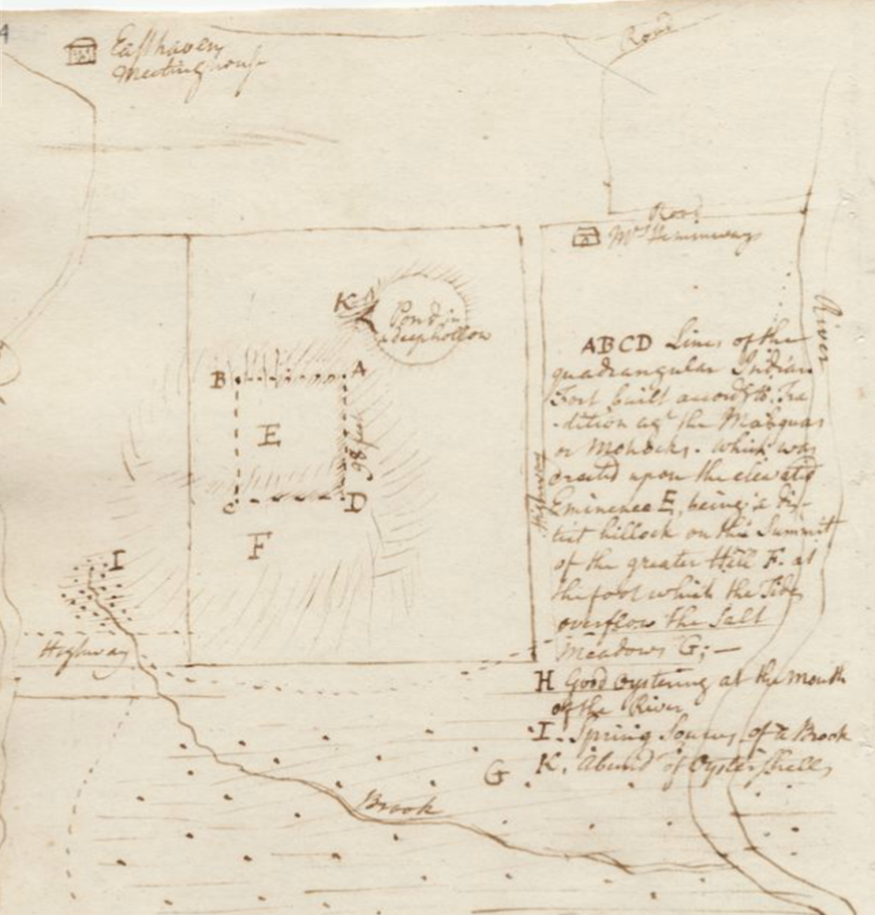
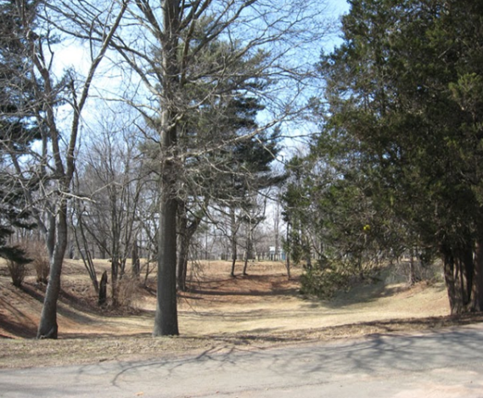
Location of the Indian Fort in what is now the Old Cemetery, East Haven
THE OLD CEMETERY

Slide 38
Pages 76-77 of The Quinnipiack Indians and Their Reservation by Charles Hervey Townshend
Showing Ezra Stile’s Itineraries of the Quinnipiac Fort in East Haven

Slide 39
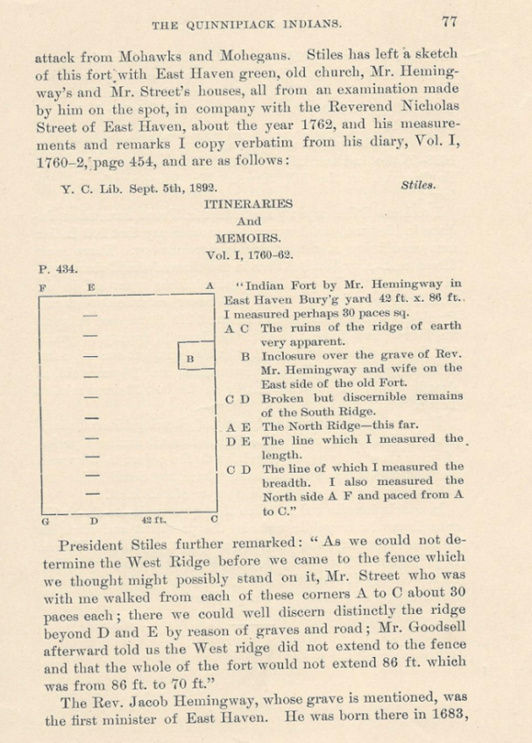
From Ezra Stile Itinineraries October 1761
Credit: Yale Indian Papers Project and Beinecke Library
The Quinnipiack Indians by Charles Hervey Townshend p. 77
Scholar’s Transcription of the digital image

Slide 40
As we could not distinguish the west ridge before we came to a fence which we thought might possible stand on it. Mr. Street who was with me having walked A & C to F & G 30 paces each: thought we could not discern or distinguish the Ridges beyond D & E by reason of Graves and a road. But Mr. Goodfell afterwards told us the West Ridge did not extend to the fence. On the whole the fort could not exceed 86 sq. feet and most probably was nearly 86 by 70. – Ezra Stiles, 1760

Slide 41
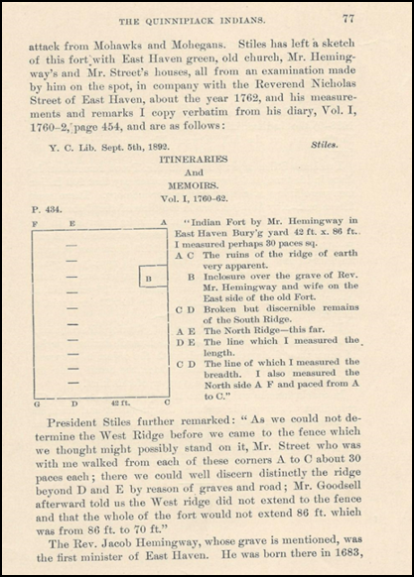
From Townshend’s Quinnipiack Indians …Stiles has left a sketch of this fort with East Haven green, old church, Mr. Hemingway’s and Mr. Street’s houses, all from an examination made by him on the spot, in company with the Reverend Nicholas Street of East Haven about the year 1762 and his measurements and remarks I copy verbatim from his diary, Vol. I 1760-2,

Slide 42
Momaguin?
Foxon?
Montowese?
We do not have a record of the thoughts and feelings of these men. We can “know” them only by the historical record of their recorded actions written by others, and through those records try to gain some understanding of who they were.

Slide 44
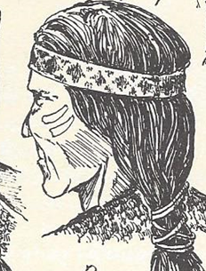
Momaguin-
His central village was
in the east side of the
harbor
His sister’s name was
Shaumpishuh and was
the Sachem ( Leader) of the Gilford Quinnipiacs
His Uncle’s name was Qussuckquansh the sachem of Branford
It is thought that he died around 1658
The first and most crucial treaty between the Quinnipiacs and the English was signed November 24th 1638.

Slide 45
Who was Momaguin? | How we can know this?- early Town Records, recorded histories, documents, deeds
Sachem of (leader or chief) Of the New Haven/East Haven band of Quinnipiacs. He was a man of authority. | “The political organization of the New England Algonquin revolved around the action of their leaders. ( Menta p. 54) In 1638 Eaton describes him as having considerable authority (Menta p. 55) November 24th , 1638 he described himself as the leading Quinnipiac Sachem
A mature individual able to lead- he remained in his office for at least twenty years until his death, despite many difficulties | John Menta in his research describes the sachems as ‘…mature individuals who had considerable influence as long as they exercised competent leadership and were not overly authoritative (p. 55)
He was able to work with others | Decisions were made with counselors
A diplomat; a provider; a mediator | “ruled by skillful, subtle diplomacy, rather than by force. Algonquin leaders were required to display their generosity by providing resources for the needy and infirm, mediate internal disputes between rival factions within the band, represent their people before the colonial governments, direct food production, negotiate trade agreements and oversee any other essential activities. (Menta p. 55 )

Slide 46
He wanted peace for himself and his family | Sought refuge in being allied with the English by treaty and expressed this
A man concerned for his people | He continued to advocate for his people to the end of his life
He represented his people during cultural conflicts, but also realized the limits of his authority | 1638-Nov 24th 1645- Montowese concluded a second agreement with Davenport and Eaton selling an additional tract of land “to run from a great pond possible Lake Saltonstall in New Haven East Meadow twenty miles north.’ p.11 1646-Incident with the dogs 1653-Momaguin complained to Governor Eaton of the need for more land for the tribe and the destruction of Quinnipiac cornfields by the English pigs, requesting construction of a fence. 1655- Momaguin – requests additional land at Oyster Point to plant on as they did not have enough land to meet their needs. 1660- (p. 11) Sold a further tract of land

Slide 47
Momauguin’s mark on the 1638 deed

Slide 48
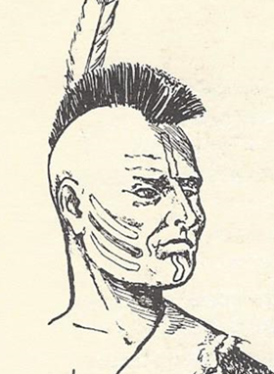
Foxon
No record of his birth
Foxon was of a band of Podunk linked by marriage and politics to the Mohegan. (Menta p. 124)
Signed deed for a tract of land in Windsor in 1636
joined up with the Sachem of the Mohegans; the notorious Uncus and most of what we know of him comes from court records of Foxon serving as Uncas’ “defense attorney”
In the mid 1600s he had a wigwam in East Haven on what is now Hunt Lane

Slide 49
“The reservation of Foxon’s group and his wigwam (then spelled “Weekwam” ) was on the plains near the river swamps and the foot of the Great Pond Rock. The reservation ran from the present shopping center, where John Howe’s farm used to be on North High Street to the area now occupied by Our Lady of Pompeii church, both sides of Route 80” Clif Nitchke “Locals got along well…

Slide 50
Who was Foxon? | How we can know this
1630s became a sagamore – a man of status and reputation and allied with the powerful Sachem Uncas | Deb Townshend Article quoting records
Intelligent | John Eliot, apostle to the Indians said that Foxon reputation was that of “a crafty, plausible councilor who was considered even among the Massachusetts tribes as the wisest Indian in the country”
Persuasive | “Great powers of conciliatory persuasion’ – Phyllis Flood article on Foxon
Powerful and influential – 1650 set up a wigwam on the Farm River | This showed how far the influence of Uncus and by association Foxon reached (Menta p. 124)

Slide 51
Montowese
A sachem in 1638 his band consisted of only ten men and “many squaws” Menta p. 18
Though he deeded his land to th
Concluded a sale of land with John Davenport and Theopilus Eaton in 1638 but reserved a small tract of land along the Quinnipiac River for his band. The exact location or even the size of Montowes’s reservation is not known, but it seems to have been in the vicinity of the present New Haven – North Haven line. P. 89
1638 – even as the fur trade decline Montowese insisted on his right to trap beaver (Menta p 66) along the Quinnipiac River and the interior regions of North Haven

Slide 52
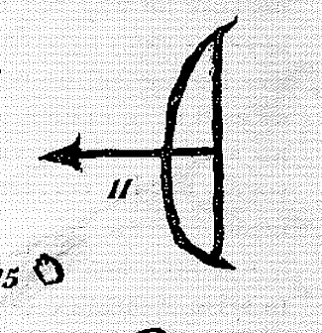
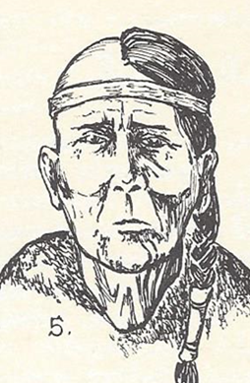
Died between 1660 and 1680 (Menta p 130)
Was the son of Sowheage, the leading sachem of the Wangunk p. 58
Led a surveying party of English interested in surveying New Haven’s northern border and officially set it’s boundry. Montowese led the group they forded the Quinnipiac River and headed north along the ancient Indian trail that had become the main road between Hartford and New Haven. The party thouroughly explored the land that had once belonged to Montowese. (Menta p. 118.
The above surveying party brought objection by the River Indians of the Hartford area who objected to Montowese’s claim to that land. The River Indians made their displeasure known to both the New Haven and Connecticut governments and they threatened to make war against the Quinnipiacs.

Slide 53
Who was Montowese? | How we can know this?- early Town Records, recorded histories, documents, deeds
Sachem of (leader or chief) Of the New Haven/East Haven band of Quinnipiacs. He was a man of authority. | “The political organization of the New England Algonquin revolved around the action of their leaders. ( Menta p. 54) In 1638 Eaton describes him as having considerable authority (Menta p. 55) November 24th , 1638 he described himself as the leading Quinnipiac Sachem
A mature individual able to lead- he remained in his office for at least twenty years until his death, despite many difficulties | John Menta in his research describes the sachems as ‘…mature individuals who had considerable influence as long as they exercised competent leadership and were not overly authoritative (p. 55)
He was able to work with others | Decisions were made with counselors
A diplomat; a provider; a mediator | “ruled by skillful, subtle diplomacy, rather than by force. Algonquin leaders were required to display their generosity by providing resources for the needy and infirm, mediate internal disputes between rival factions within the band, represent their people before the colonial governments, direct food production, negotiate trade agreements and oversee any other essential activities. (Menta p. 55 )

Slide 54
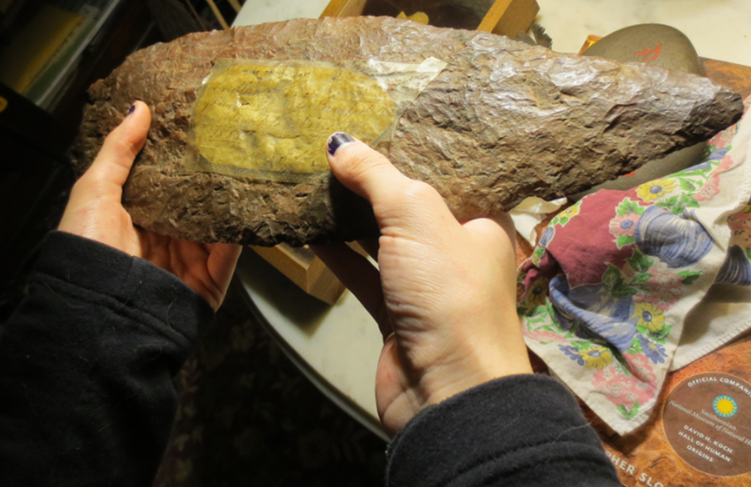
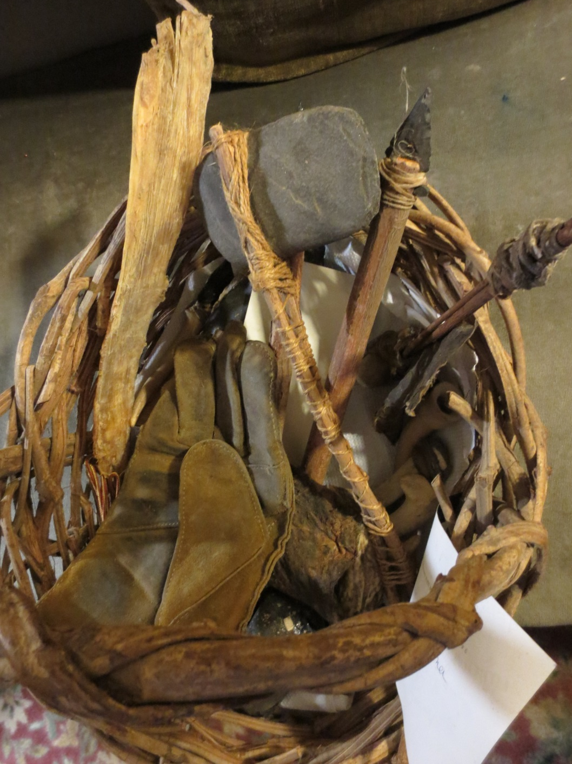
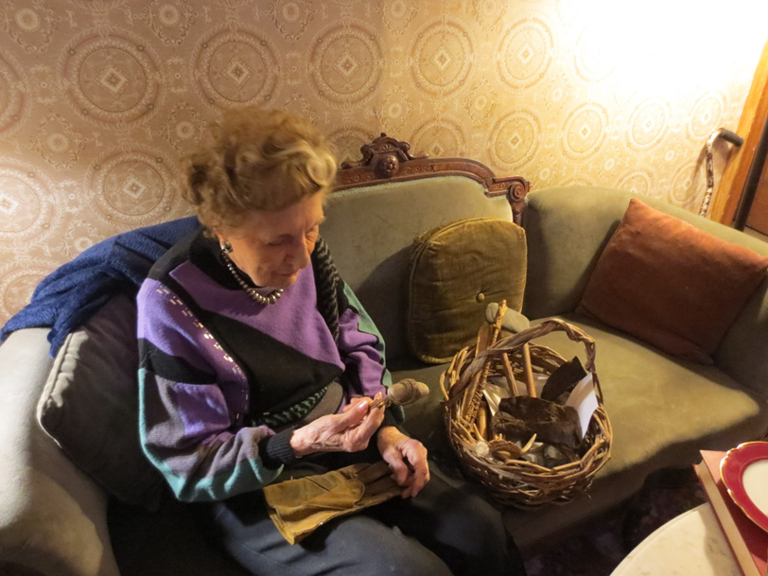

Slide 55
Sources:
All sketches –
by C. Keith Wilbur from The New England Indians copyright 1978 The Globe Pequiot Press. Used with permission.
Photos and information from: The Quinnipiack Indians and Their Reservation by Charles Hervey Townshend, copyright 1900. Used with the kind permission of Doris Townshend.
Also
Whatever Happened to the Quinnipiacs? By Doris B. Townshend, copyright 2008. Used with kind permission.
The Quinnipiac: Cultural Conflict in Southern New England by John Menta, copyright 2003.
And the Town Green Tree Preservation Project Brochure of East Haven

